Slide 1
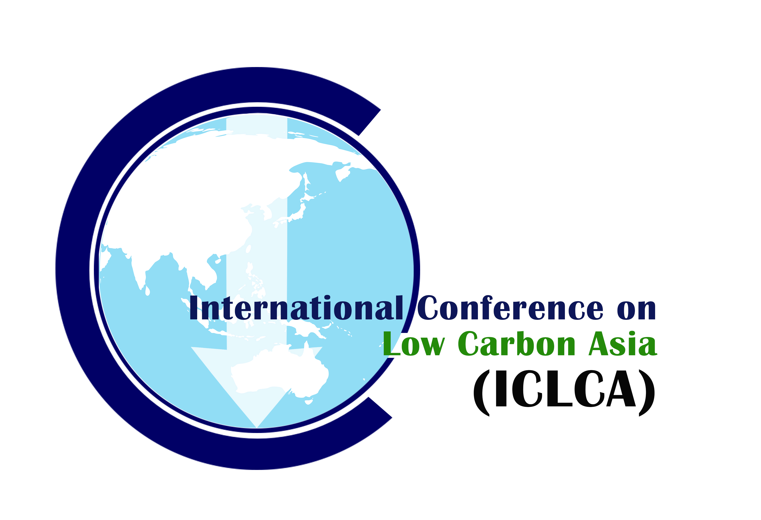
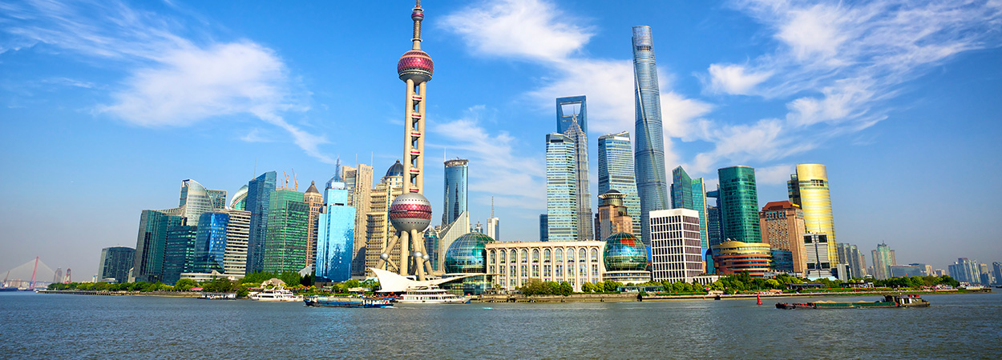





[Virtual Conference] 6th International Conference on Low Carbon Asia & Beyond - ICLCA 2020 1-3 September 2020 Shanghai, China “Urban Sustainability towards Human Well-Being”
www.iclcaconf.com

Slide 2
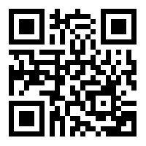
Virtual Conference- 6th ICLCA 2020
TOPICS
Urban Planning & Smart Cities
Sustainable Energy Systems
Sustainable Urban Waste & Water Management
Sustainable Urban Food Production
Nexus & Circular Economy
Cleaner Technology
ABSTRACT SUBMISSION
Authors wishing to present a contribution would prepare a one-page abstract. Submission link: http://registration.sdewes.org/iclca20
REGISTRATION FEES
Registration covers the presentation of 1 paper.
Registration | Early bird, USD | Normal, USD
Standard participant | 120 | 200
Student | 80 | 120
IMPORTANT DATES (2020)
1 Dec : Abstract Open
30 April : Abstract due
15 May : Abstract acceptance 30 May : Full paper submission due 30 June : Early Bird Due
15 Aug : Normal registration, & final acceptance due
1-2 Sep : Conference
PUBLICATION POLICY
To present in this conference, the author can choose to submit an abstract only or a 6 pages full paper. The accepted full paper will be published in Scopus indexed journal with additional processing cost. One paid presenter is entitled to presentation of only one paper, and publication maximum of one Scopus indexed journals (additional cost is applicable for each paper). Both accepted abstract or full paper will be invited for special issues, subject to the quality and scope of papers.
Potential Special Issues
Journal of Cleaner Production (Elsevier) [ISI; Q1]
Energy (Elsevier) [ISI; Q1]
Sustainability [ISI]
Chemical Engineering Transaction [Scopus, EI]
School of Environmental Science & Engineering,
Shanghai Jiao Tong University,
800, Dongchuan Road, Minhang,
Shanghai, CHINA
UTM Low Carbon Asia Research Centre,
Universiti Teknologi Malaysia
81310 Johor Bahru, Johor, MALAYSIA
www.iclcaconf.com fb.me/iclcaconf secretariat@iclcaconf.com

